Slide 1
Economics
Fiscal policy in post reform period & fiscal deficit in india
GROUP - 11

Slide 2
What Is Fiscal Policy
Fiscal Policy refers to the overall effect of the budget outcome on economic activity.
So in general, Fiscal Policy = Revenue + expenditure policy by Gov. Of India

Slide 3
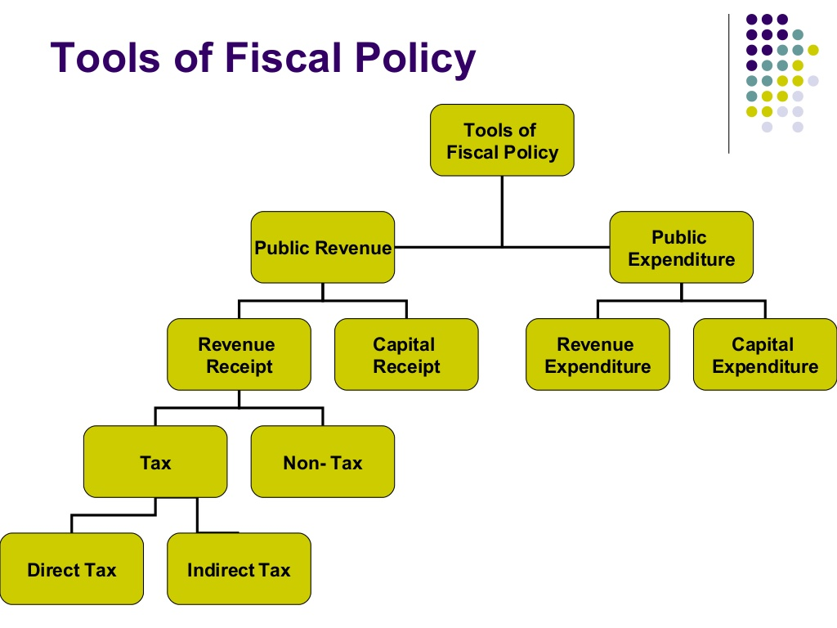

Slide 4
Expenditure and Funding
Government spend money on a wide verity of things, from the military to services like Education and healthcare, as well as transfer payments.
This expenditure can be funded in a number of different ways:
Taxation Revenue
The benefit from printing money (Seigniorage)
Borrowing money
Consumption of fiscal reserves
Sale of fixed assets (e.g. Land)

Slide 5
1960-80
Tax Revenue to GDP Ratio Improved from 6.3 % to 16.1 %
Some country like Sweden has Tax to GDP ration is around 54 %
Excise Duty & Customs Duty,
Cascading Effect of such taxes
1960-70
High Personal & Marginal Income Tax Rates
1957-58
Wealth Tax, Expenditure Tax, Gift Tax
1953
Taxation Enquiry Commission

Slide 6
1970-1990
Taxation & Expenditure Policies more focused on achieving social justice & equality
Public Expenditure were constantly increasing in compare with revenue generated from high marginal tax
1980s- A Decade of Fiscal Deterioration, resulted in macroeconomic crisis of 1991
Public Finances was in a state of disarray, persistent large deficits
Eleven Tax Brackets used as a means to reduce income inequality
Corporate Income Tax between 45-65 % for widely held companies
The Direct Taxes Enquiry Committee of 1971 found that the high tax rates encouraged tax evasion.

Slide 7
1974-75: Based on committee’s recommendation- personal tax was brought down.
1978 -85: Number of Income Tax brackets were reduced from 11 to 8 and finally to 4.
Highest Income Tax rate was brought down from
97.5% to 50%.

Slide 8
1991: Crisis
Gulf crisis of 1990--- increase in oil import bill
Exports were down significantly due to breakdown of Soviet Union
Deterioration in the Exchange Rate of Rupee

Slide 9
LIBERALIZATION
We did away with many of the import restrictions. Until 1991, we imposed a 400% customs duty on many products. Industries had to beg to get an essential ingredient imported. By 1991, the duties on many products were reduced substantially. This brought new growth in our industries.
Import licensing was abolished. Until 1991, you need a license to import anything and this license was very hard to get.
Government did away with the production licensing in many industries. Until 1991, you needed government's permission in what to produce and how much to produce. In one stroke, the restriction was removed in many industries.
Government started selling some of its businesses to the private. This brought cash and new round of efficiency.

Slide 10
TAX REFORMS
Reducing the corporate tax rate on both domestic and foreign companies and was reduced to 35 percent till 1997
Rationalization of capital gains tax and dividend tax and excise duties
Value Added Tax (VAT), improving taxation of agriculture tax administration.
Minimum Alternate Tax was introduced in 1996-97. It required a company to pay a minimum of 30 percent of book profits as tax
Total tax revenues of the centre were 9.7 percent of GDP in 1990-91. They declined to only 8.8 percent in 2000-01.
As a part of the subsequent direct tax reforms, the personal income tax brackets were reduced to three with rates of 20, 30 and 40 percent in 1992-93.
Tax concessions were also given to non-residents to encourage flow of foreign exchange.

Slide 11
Tax concessions were also given to non-residents to encourage flow of foreign exchange remittances.
lowering the maximum marginal rate on personal income tax
Widening of the tax base by including
introduction of presumptive taxes,
Adoption of a set of six (one-by-six) economic criteria for identification of
potential tax payers in urban areas
taxation of services

Slide 12
Minimum alternate tax was introduced in 1996-97 .(30 percent profit as tax)
VAT was introduced in 2000-01 which contains all the three taxes under MODVAT
CUSTOM DUTY TREND IN NON – AGRICULTURE GOODS
150% - 1991/92
40% - 1997/98
30 % -2002/03
15% - 2005/06

Slide 13
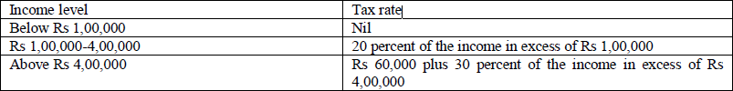
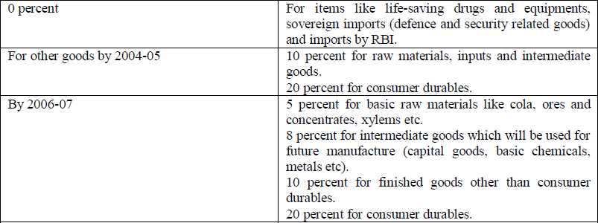
YEAR 2002
PERSONAL INCOME TAX
INDIRECT TAX SUGGESTION BY TASK FORCE

Slide 14
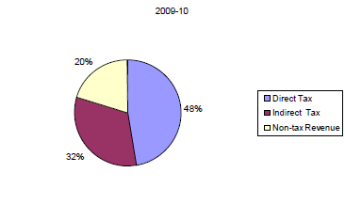
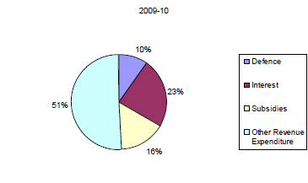
Revenue and Expenditure

Slide 15
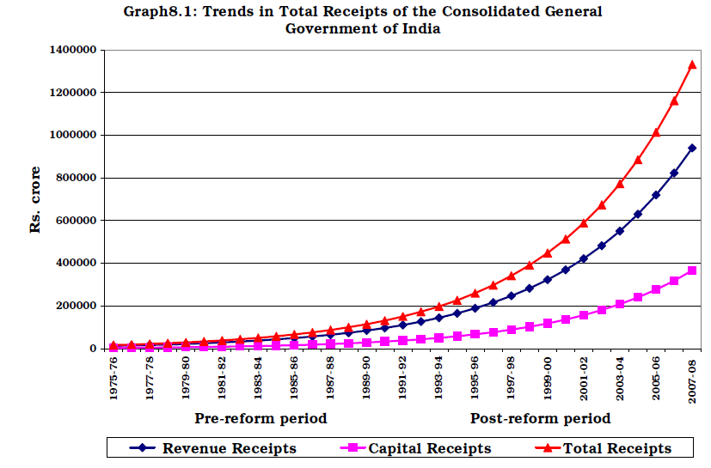

Slide 16
FISCAL DEFICIT

Slide 17
The difference between Total Revenue and Total Expenditure of government is defined as Fiscal Deficit.
If the government spends more than it earns than it has a situation which is called fiscal deficit.
fiscal deficit = Government spending - Government revenue

Slide 18
A deficit is usually financed through borrowing from either central bank of the country or raising money from capital markets by issuing some instruments like treasury bills and bonds.
The two main instruments of fiscal policy are changes in level and composition of taxation and government spending in various sectors.

Slide 19
IN INDIA
In India Fiscal Deficit is financed by obtaining funds from Reserve bank of India called Deficit Financing.
The fiscal deficit is also financed by obtaining funds from the money market(primarily from the banks)

Slide 20
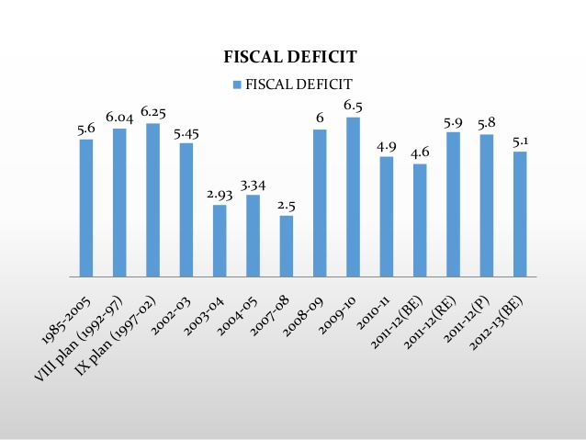

Slide 21
Causes of Fiscal Deficit
Payment of interest.
Poor perfomance of public sector.
Tax evasion.
Excessive government borrowing.
Increase in subsidies.
Defence expenditure.
Social services like education, health, etc,.

Slide 22
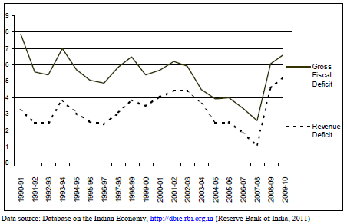

Slide 23
Ways to reduce fiscal deficit
Proper Distribution System
Raising import taxes and prices of petroleum products.
Subsidy at the input level.
Cutting down the expenses on government debts.
Improve the government investement.

Slide 24
THANK YOU

